Slide 1

Loan Approval Prediction
Project 1
Team 2
Abhilasha Singh Aswin Balaji Thippa Ramesh Lixing Pan
IDS 6101

Slide 2
Purpose
Summarize important background research and EDA
Answer the SMART question(s) by building models

Slide 3


Exploratory Data Analysis (EDA)
Dataset Details
Insight:
Loan approval dataset
20000 observations
36 variables

Slide 4

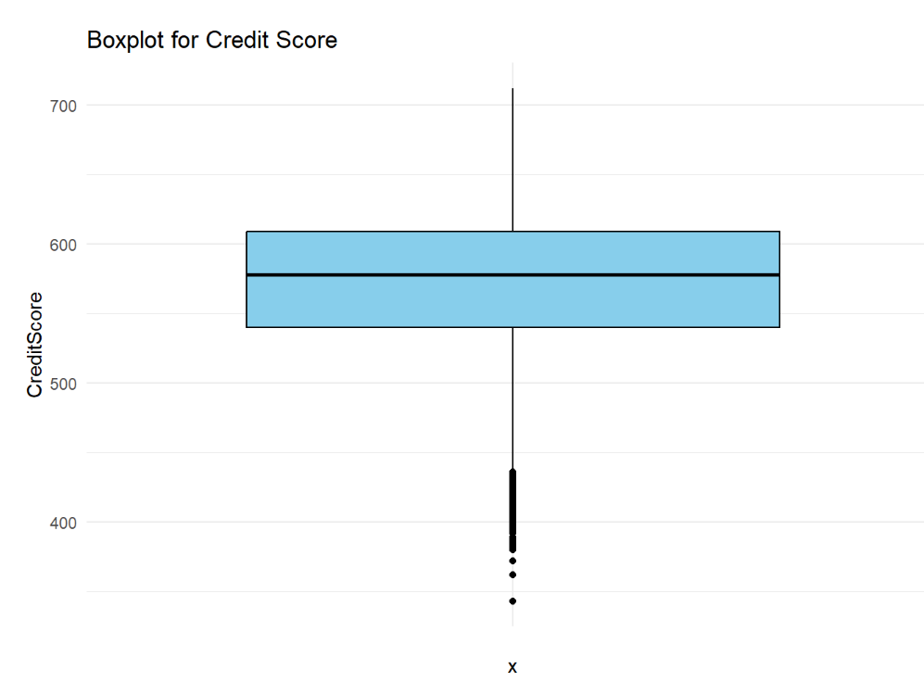
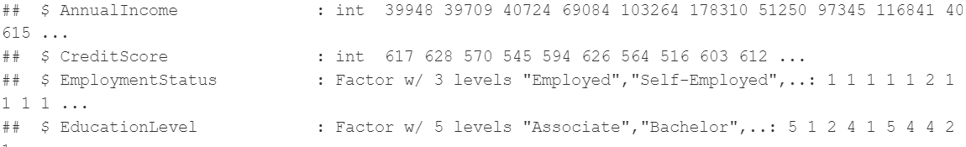
Exploratory Data Analysis (EDA)
Preprocessing for Analysis
Insight:
No missing values
No duplicate rows
Outliers
Data Types

Slide 5
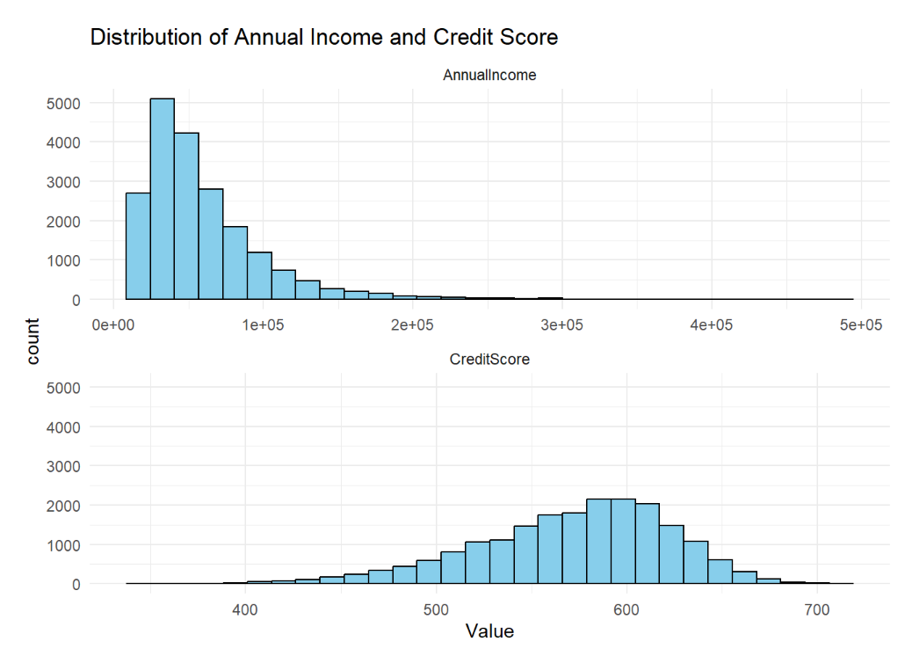
Exploratory Data Analysis (EDA)
Univariate Analysis
Insight:

Slide 6
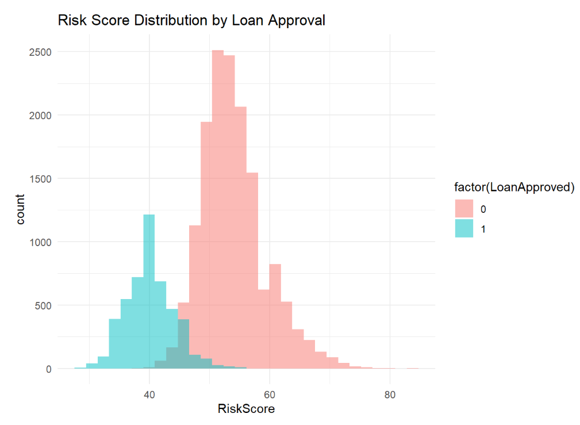
Exploratory Data Analysis (EDA)
Bivariate Analysis
Insight:

Slide 7
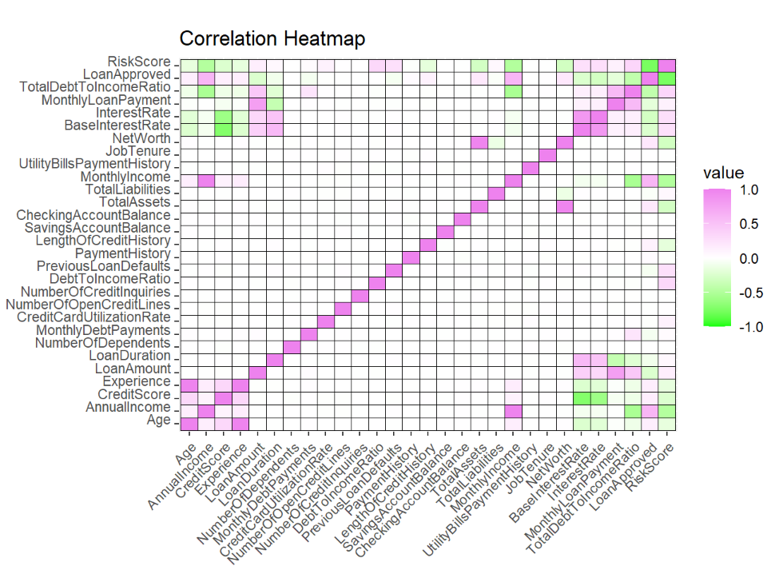
Exploratory Data Analysis (EDA)
Multivariate Analysis
Insight:
Annual income, Risk Score, TotalDebtToIncomeRatio, Annual Income and Monthly Income are the highly correlated variables with that of loan approval.

Slide 8
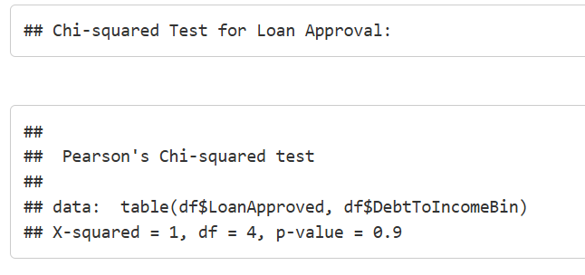
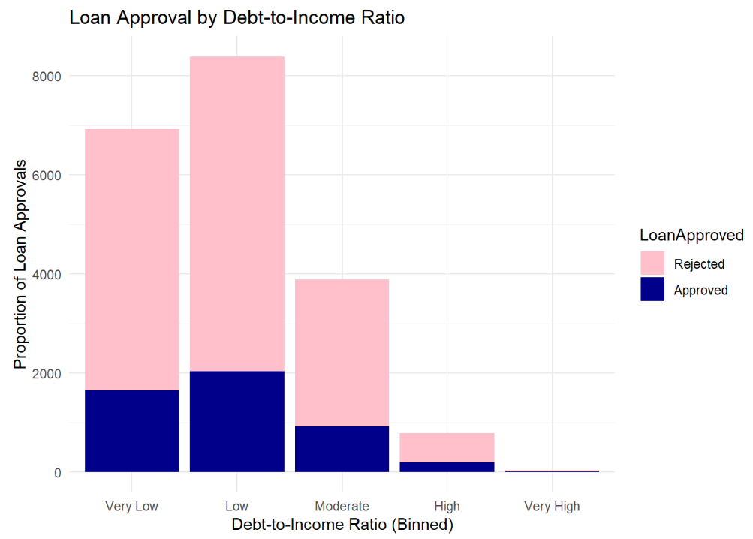
Smart Questions
1. How does the debt-to-income ratio impact loan approval, interest rates, and risk scores?
Debt-to-income Ratio Impact on Loan Approval
Insight:

Slide 9
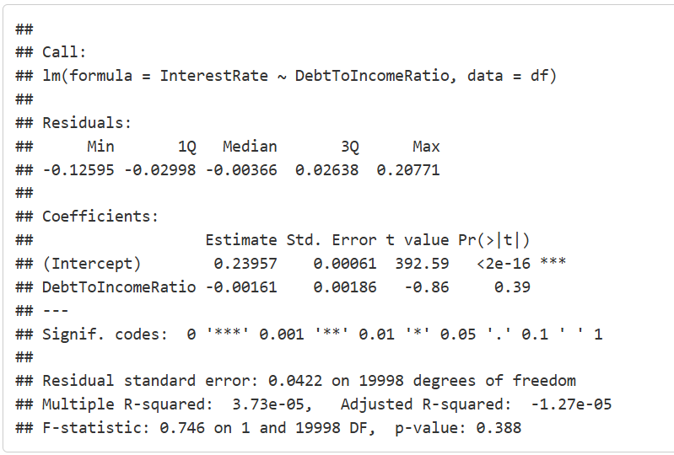
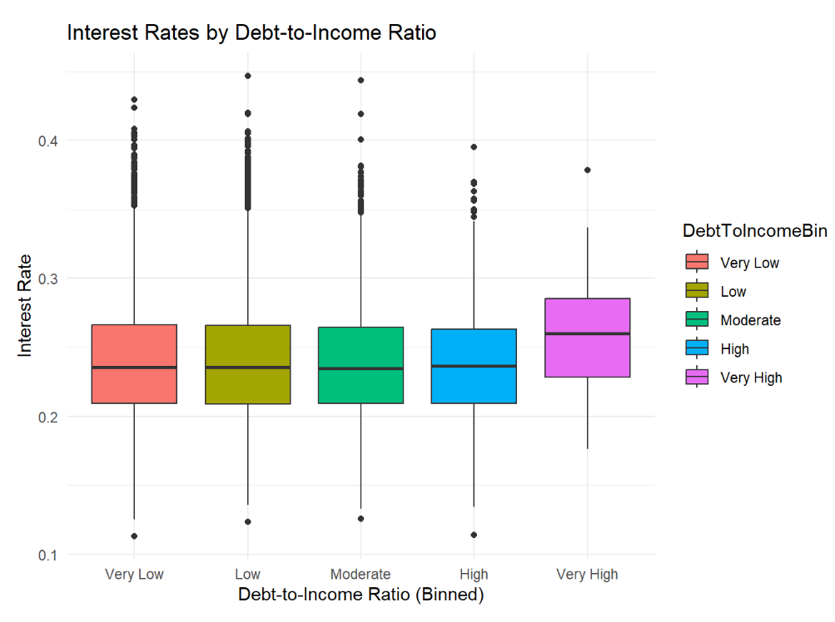
Smart Questions
1. How does the debt-to-income ratio impact loan approval, interest rates, and risk scores?
Debt-to-income Ratio Impact On Interest Rates
Insight:

Slide 10
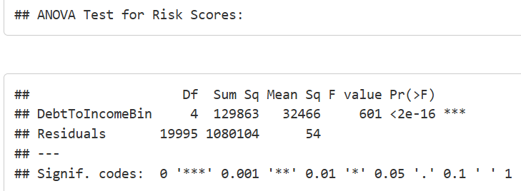
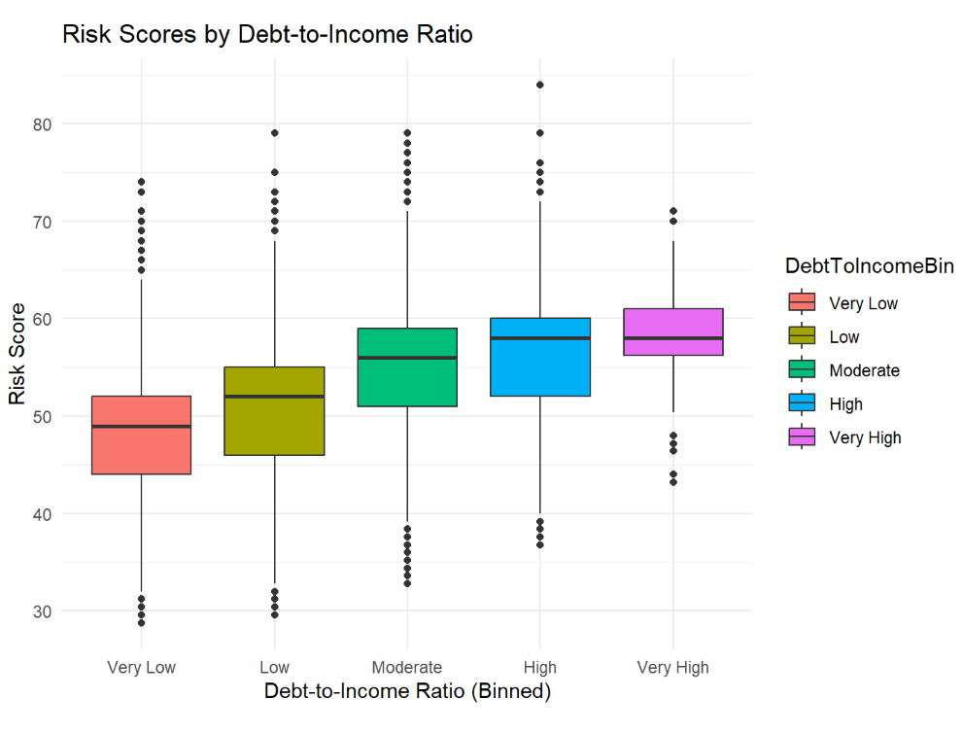
Smart Questions
1. How does the debt-to-income ratio impact loan approval, interest rates, and risk scores?
Debt-to-income Ratio Impact on Risk Scores
Insight:

Slide 11
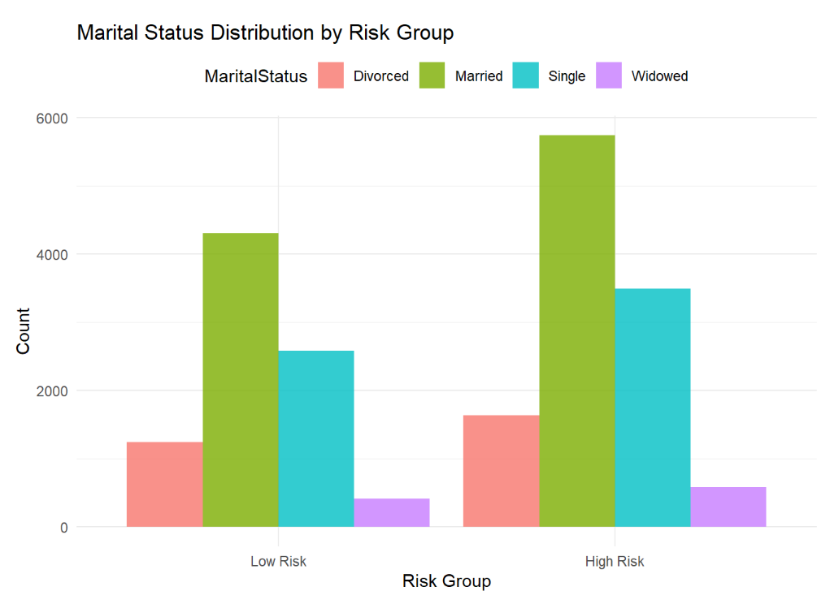
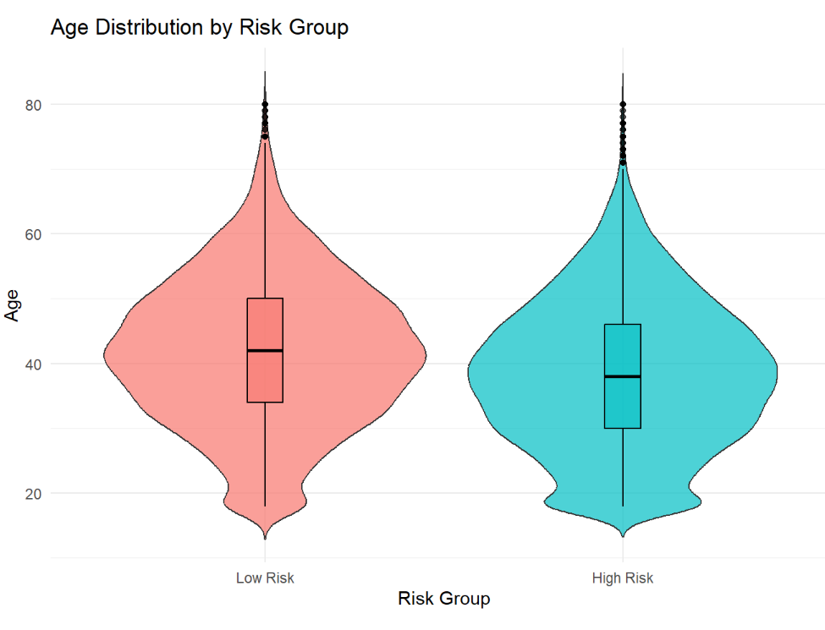
Smart Questions
2. What are the financial and demographic profiles of high-risk versus low-risk applicants?
Insight:
Low-risk applicants are predominantly married, while high-risk applicants have higher proportions of single and divorced individuals.
Low-risk applicants tend to be older, while high-risk applicants are generally younger.

Slide 12
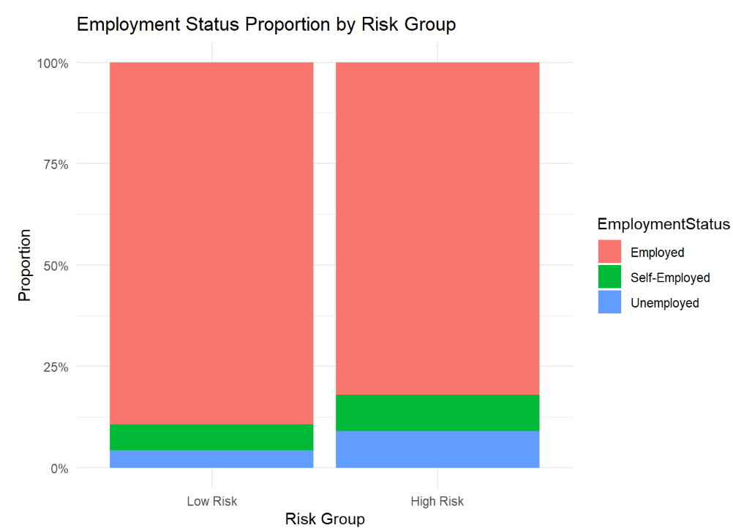
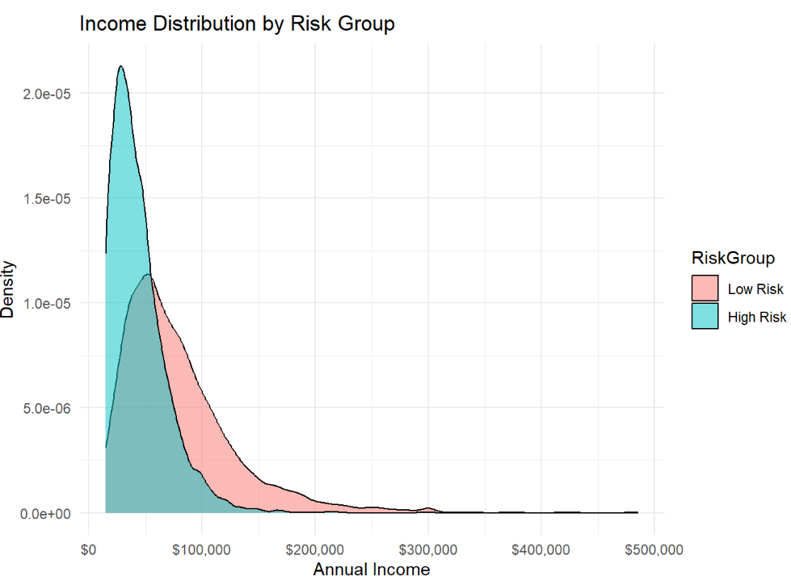
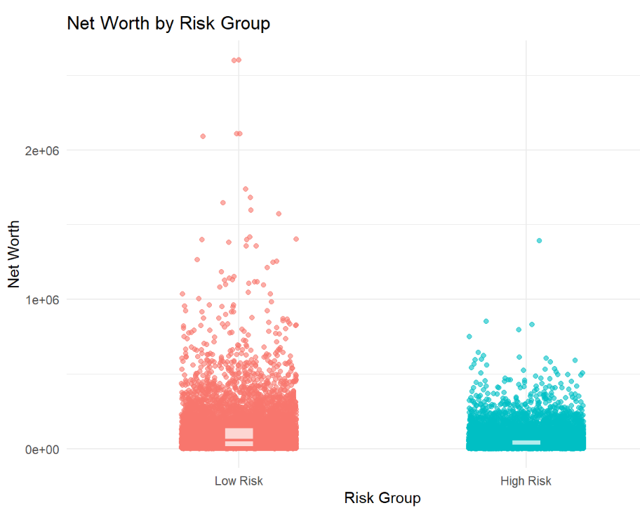
Smart Questions
2. What are the financial and demographic profiles of high-risk versus low-risk applicants?
Insight:
High-risk applicants have a slightly higher proportion of unemployment compared to low-risk applicants, while most are employed in both groups.
Income distribution for low-risk applicants is skewed higher compared to high-risk applicants, who predominantly have lower incomes.
Low-risk applicants have significantly higher net worth compared to high-risk applicants, with greater variability in the low-risk group.

Slide 13
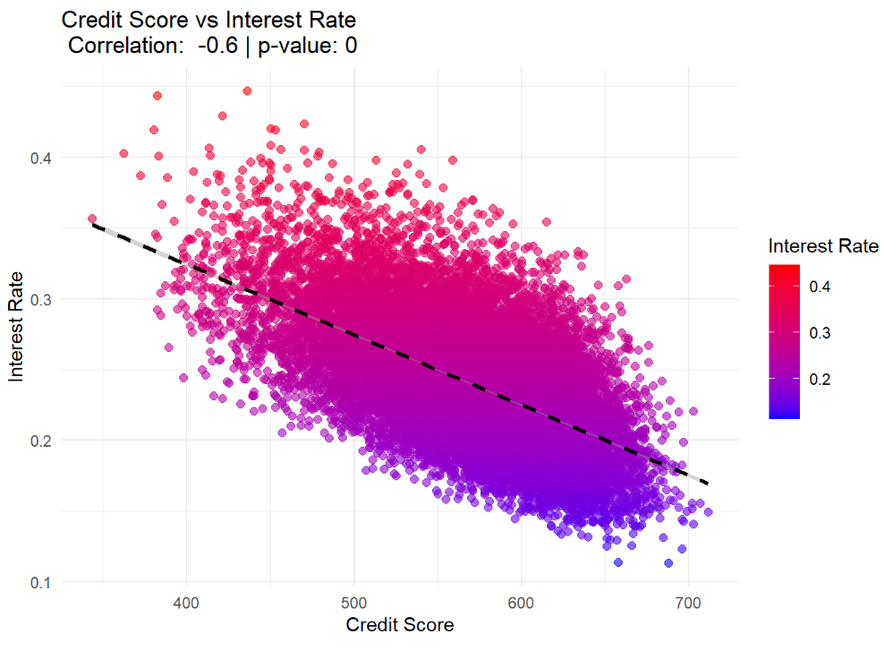
Smart Questions
3. How does credit score impact interest rates, loan approval, and loan amount?
Credit Score Impact On Interest Rates
Insight:

Slide 14
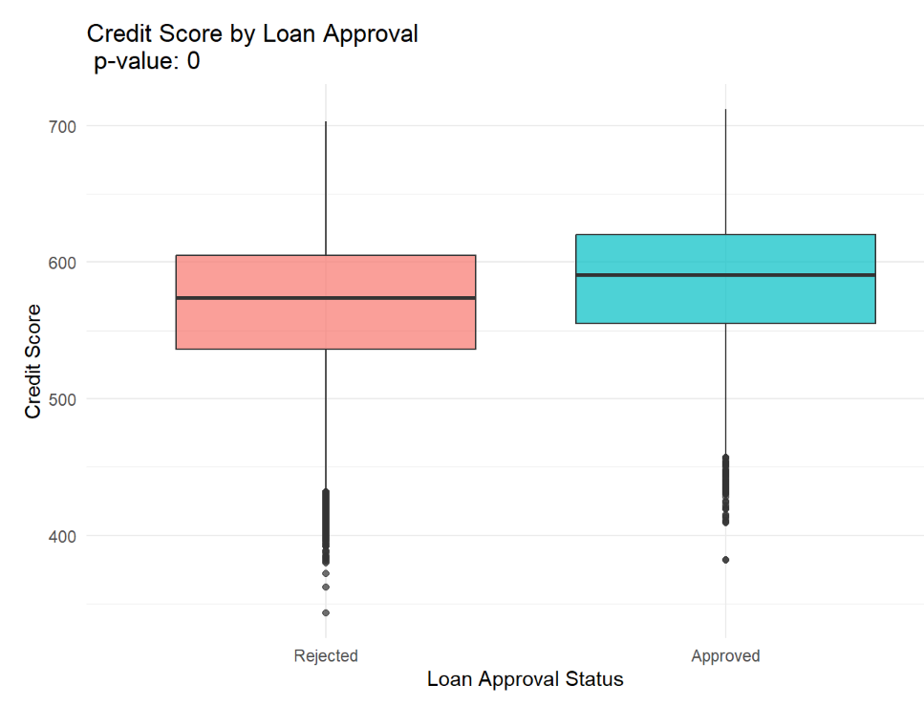
Smart Questions
3. How does credit score impact interest rates, loan approval, and loan amount?
Credit Score Impact On Interest Rates
Insight:

Slide 15
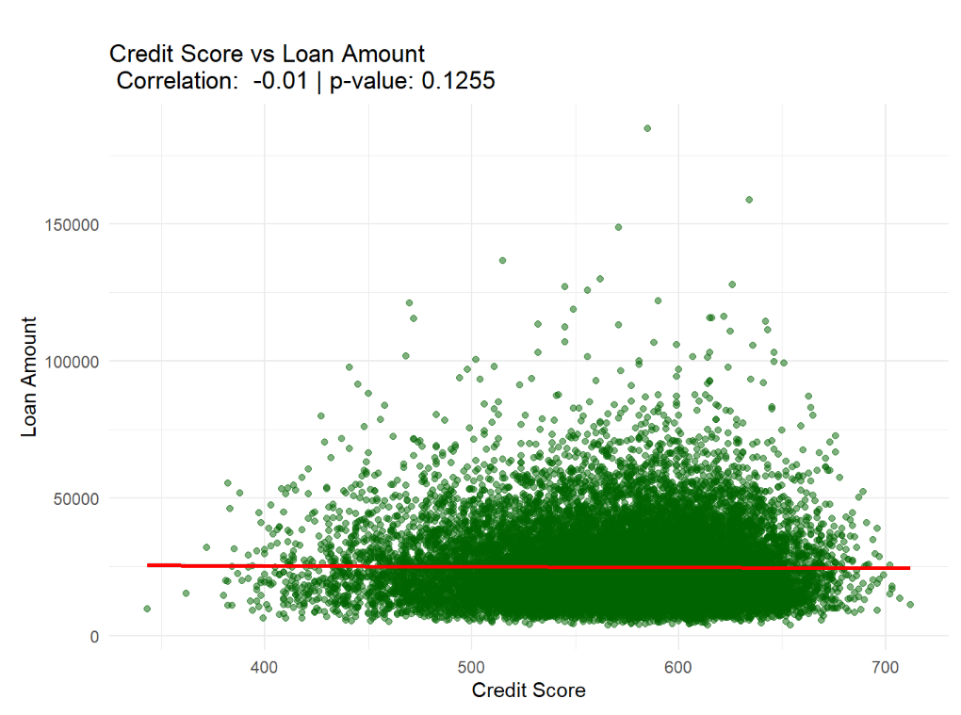
Smart Questions
3. How does credit score impact interest rates, loan approval, and loan amount?
Credit Score Impact On Interest Rates
Insight:

Slide 16
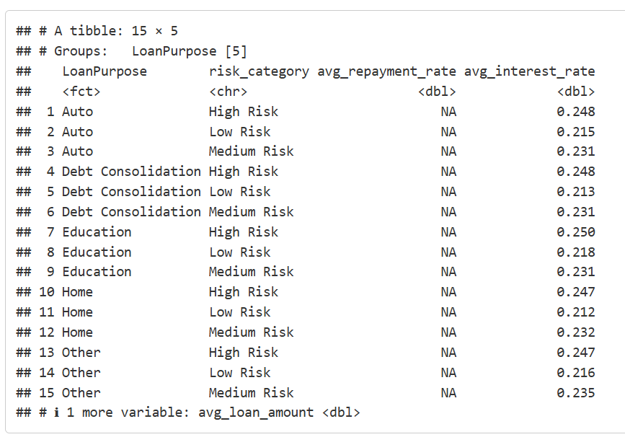
Smart Questions
4. What is the relationship between loan purpose and repayment behavior, and how does it affect risk?
Debt-to-income Ratio Impact on Risk Scores
Insight:

Slide 17
Smart Questions
5. What are the strongest predictors of loan approval?
Insight:

Slide 18
Smart Questions
4. What is the relationship between loan purpose and repayment behavior, and how does it affect risk?
Insight:

Slide 19

Conclusion

Slide 20

Any thoughts or questions?

